Slide 1

UNTAPPED ENERGY 2018 Oil and Gas Datathon
Health and Safety Pod Data Workshop Oct 12 - 14, 2018

Slide 2

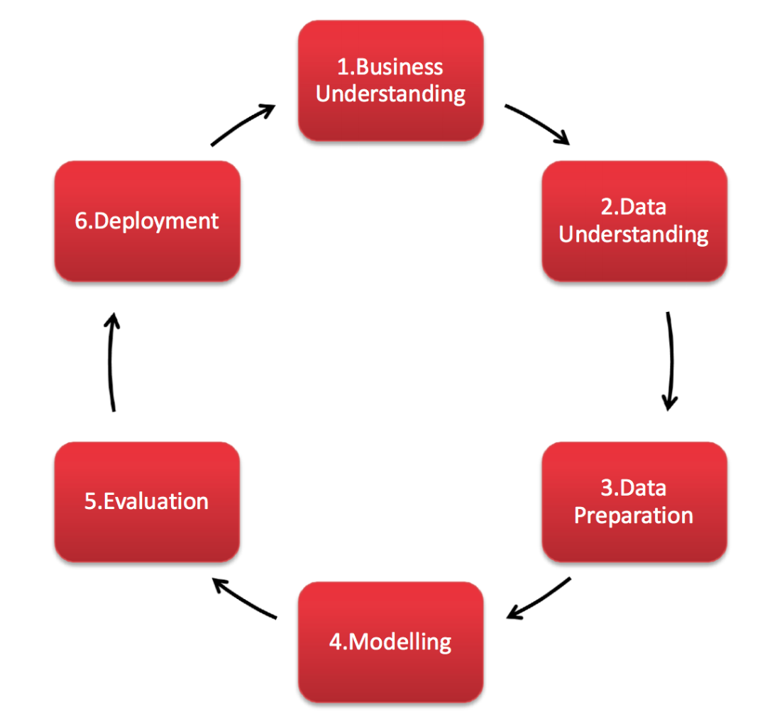
Agenda
Introductions
1. Business Understanding
Let’s get some Insights from our H&S Experts
What are the Challenges we are facing
What are our Objectives
2. Data Understanding
What Data do we have - What does it look like
3. Data “Preparation” - Let’s get creative!
4 scenarios to enable Data and Information Discovery

Slide 3
Introductions
Your Name
Your Expertise and Profession
Why did you choose the Health & Safety Pod?
… and something Personal about you: What did you do for Vacation this Year?

Slide 4

CRISP-DM Step 1. Business Understanding
Let’s get some Insights from our H&S Experts
A Skype Session with Waqar Mughal, waqar@mamc.ca

Slide 5

CRISP-DM Step 1. Business Understanding
What are our Challenges?
Legal and regulatory barriers
companies and institutions need assurance that privacy of data is protected
that raw data is appropriately scrubbed
Industry barriers
industry is hesitant sharing raw, unprocessed data
companies collect data predominantly for internal purposes only
companies report only statistical information as required
data is focused on outcomes and prevention - not causal

Slide 6
CRISP-DM Step 1. Business Understanding
What are our Objectives for Health & Safety?
Cross-company Collaboration in Data Analysis
What is preventing the Energy Industry from getting to a Zero Incident Rate?
Could we create a personalized safety alert for workers alerting to safety considerations considering training, previous history, location, contributing factors, equipment, weather, etc
Determine a comprehensive set of contributing factors into categories:
the heuristic traps (familiarity), not challenging status quo (not asking questions), attitudes, mental state, training, beliefs, cultural aspects at the worksite, stress, etc.
How can this type of information be obtained and brought into the analysis?

Slide 7
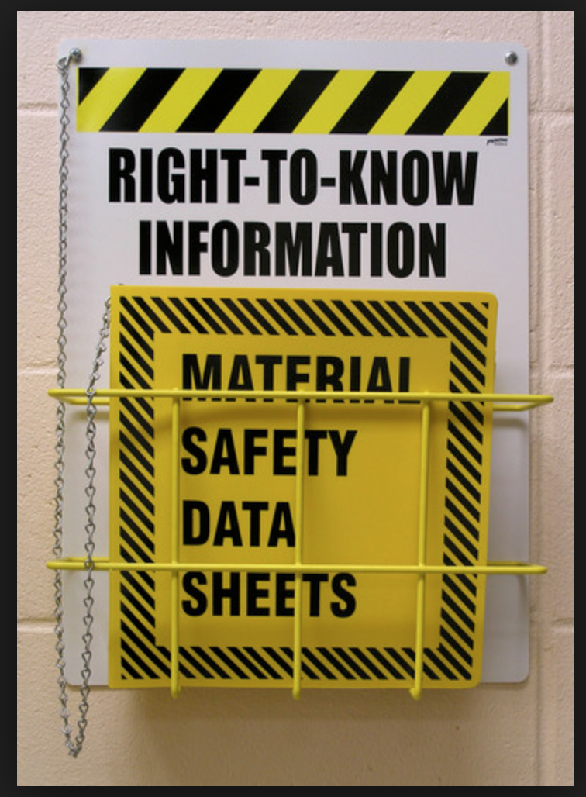
CRISP-DM Step 2. Data Understanding
What Data do we have - What does it look like?
Meta data
Government data
WCB/AWCBC data
Pipeline Incident data
Industry analysis
Learnings from the UK and Europe

Slide 8
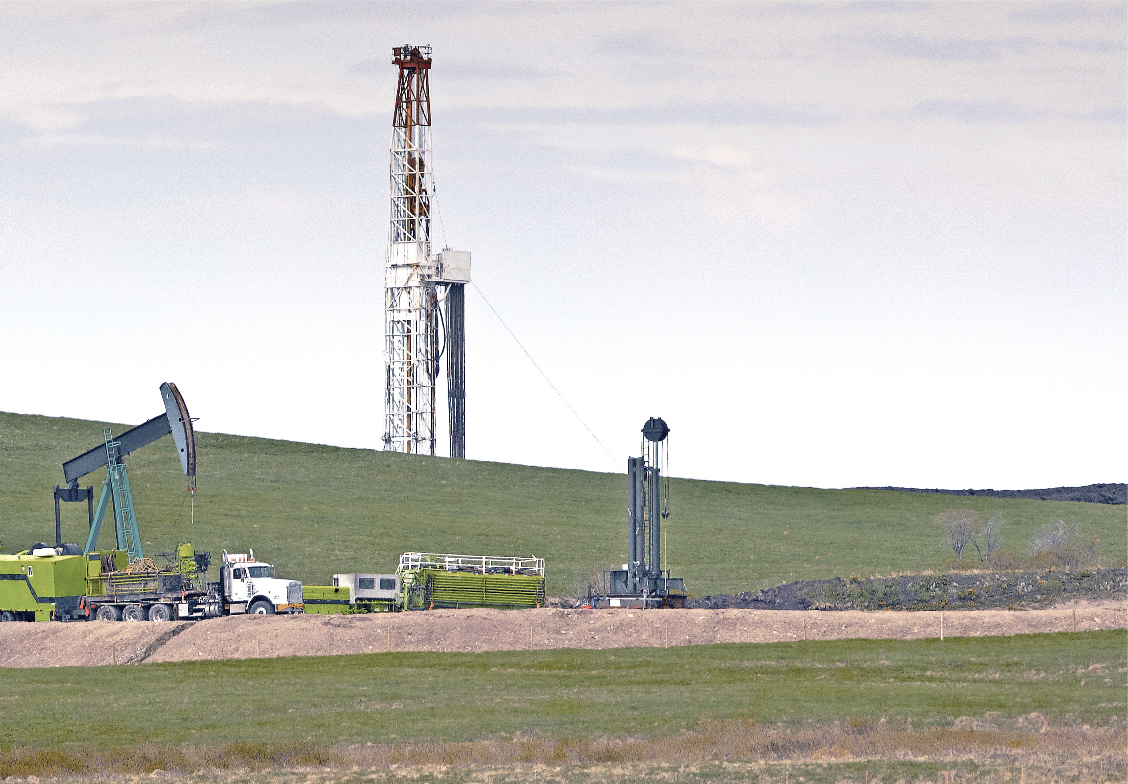
CRISP-DM Step 2. Data Understanding
2014 NIOSH Data
18% of fatalities were motor vehicle accidents
15% of fatalities were struck by falling object
15% by explosion or fire
45% of fatalities were from servicing company workers with the most common being MVA
National Institute for Occupational Safety and Health

Slide 9
CRISP-DM Step 3. Data “Preparation”
Scenario 1: What can we learn from WCB data available?
Most common injury type
Most common body location
Prevalent age groups
Other patterns
Scenario 1: What is missing from WCB data?
What data is needed to enable analysis
What data is needed to determine: Why did this accident happen?
What other data should be combined with WCB data?
Here we need your creative Data Analytical Experience - let’s brainstorm

Slide 10

CRISP-DM Step 3. Data “Preparation”
Scenario 2: Developing a Safety Management Plan for a Company
What type of training reduces the incident rate?
When does weather become a factor to the incident rate?
How can lessons learned from actual incidents reduce future incident rate?
What other critical factors (categories) need to be incorporated and how?
Emotional state, work-life balance, work distractions, complacency, etc?
Material and equipment failure, not following process, etc
Here we need your creative Data Analytical Experience - let’s brainstorm

Slide 11

CRISP-DM Step 3. Data “Preparation”
Scenario 3: Motor Vehicle Accident
EXPOSURE: ENVIRONMENTAL
Activities: Commuting: non-traditional Motor vehicle travel
Two workers were on their way home after completing a casing job. Heavy rainfall caused flash flooding in the area and their vehicle was unable to cross an intersection due to high water. Both workers exited the vehicle to climb to safety and wait for help. After leaving the vehicle, one of the workers went missing and was found deceased by law enforcement. The other worker was able to climb to safety. Flooding in this area caused more than 100 oilfield workers to be stranded.
Here we need your creative Data Analytical Experience - let’s brainstorm
Notes:
issues with truck drivers having to wait long times at loading facilities and then having to drive distances to deliver the load. They get fatigued and distracted,

Slide 12
CRISP-DM Step 3. Data “Preparation”
Scenario 3: Motor Vehicle Accident
Oilfield workers are eight times more likely to be involved in a fatal vehicle accident while on the job, a disproportionate number of these wrecks happening to employees of well-servicing companies.
Data drawn from the Bureau of Labor and Statistics indicate that fatal vehicle accidents account for 28 percent of all oilfield fatalities, making it the leading cause of death in the industry.
More than half of these deadly accidents happen in a pickup truck, which doesn’t require drivers to receive any special training before driving one.
Over 50 percent of vehicle accident-related oilfield fatalities were single-vehicle accidents, suggesting that worker fatigue could be a contributing factor — or the fact that many oilfield workers tend to be younger and more likely to take risks.
The driver’s failure to use a seatbelt was listed as a contributing factor in most of these deaths. Had they been clicked in place, more than 60 percent of the fatalities could have been avoided.
Companies with fewer than 20 employees — and less likely to dedicate adequate time and money toward safety training — had the highest incidence of vehicular oilfield fatalities.
Notes:
Is there a role for sensors, micro sensors, wearables?

Slide 13
CRISP-DM Step 3. Data “Preparation”
Scenario 4: What can we learn from Pipeline Incident data available?
Most common pipeline incident
Most common pipeline incident causing injury or fatality
Any specific patterns worth noting
Scenario 4: What is missing from Pipeline Incident data?
What data is needed to enable analysis
What data is needed to determine: Why did this incident happen?
What other data should be combined with this data?
Here we need your creative Data Analytical Experience - let’s brainstorm

Slide 14
Wrap-up for the Day
De-brief on the learnings from today - ensure everything is captured
Any questions?
Agenda for Sunday:
8 a.m. - Breakfast
8:30 a.m. - Welcome and final instructions
9:00 a.m. - Pods complete reports/presentation
12:00 p.m. - Lunch
1:00 p.m. - Prod presentations
Closing remarks by Ian MacGregor
5:00 p.m. - Datathon concludes

Slide 15

Wrap-up for the Day

